Slide 1


Deep Learning for Natural Language Processing DLNLP 3: Logistic Regression
Mihai Surdeanu and Marco A. Valenzuela-Escárcega

Slide 2
Take away
Logistic regression (LR) decision function
Learning algorithm for LR
LR cost function
Gradient descent
Deriving the LR update rule
From binary to multiclass classification
Evaluation measures for multiclass classification
Drawbacks

Slide 3
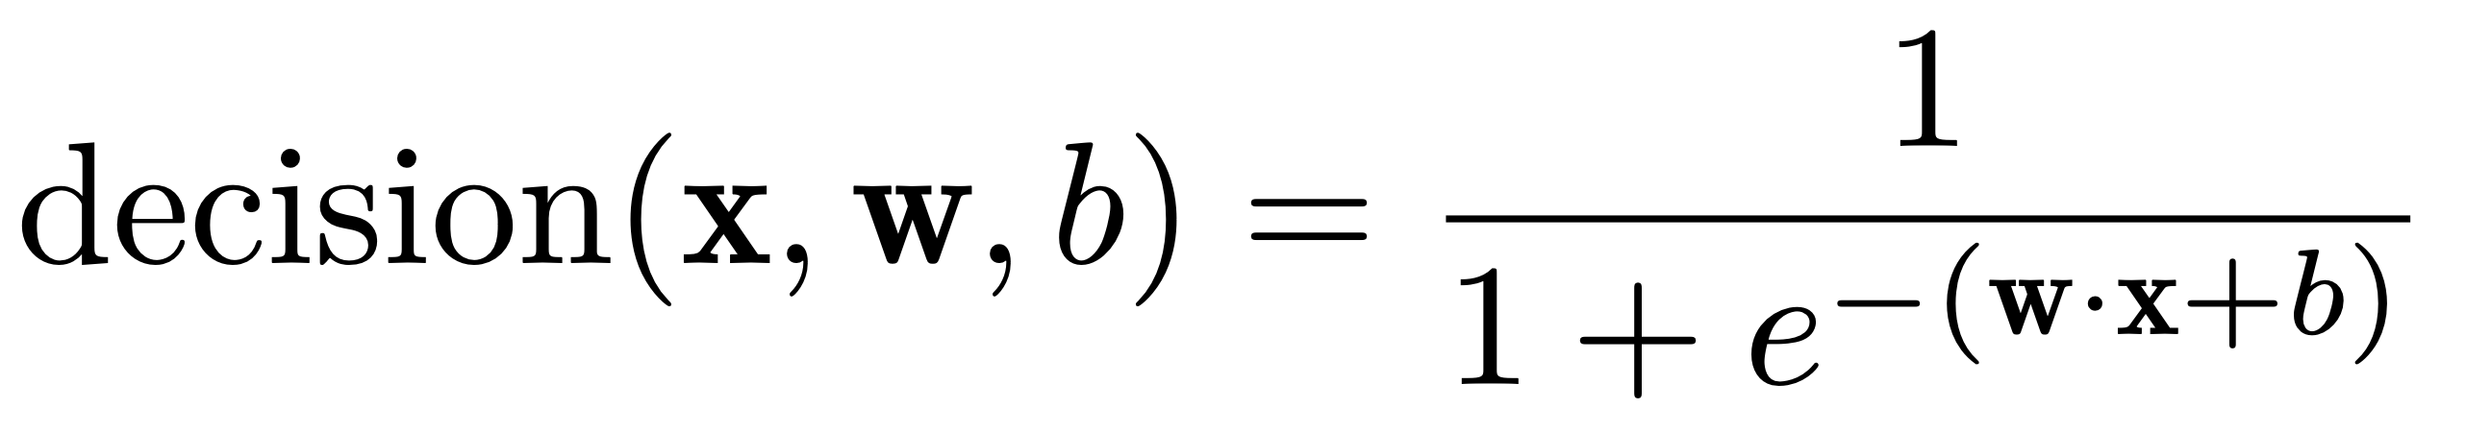
First change from perceptron: decision function
Logistic function, part of the sigmoid function family

Slide 4
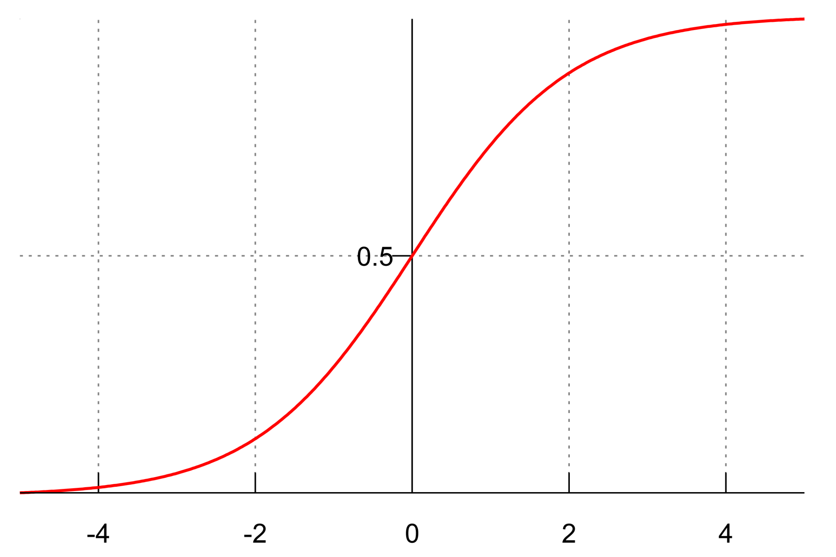
Logistic function
Why is this better than the perceptron decision function?

Slide 5
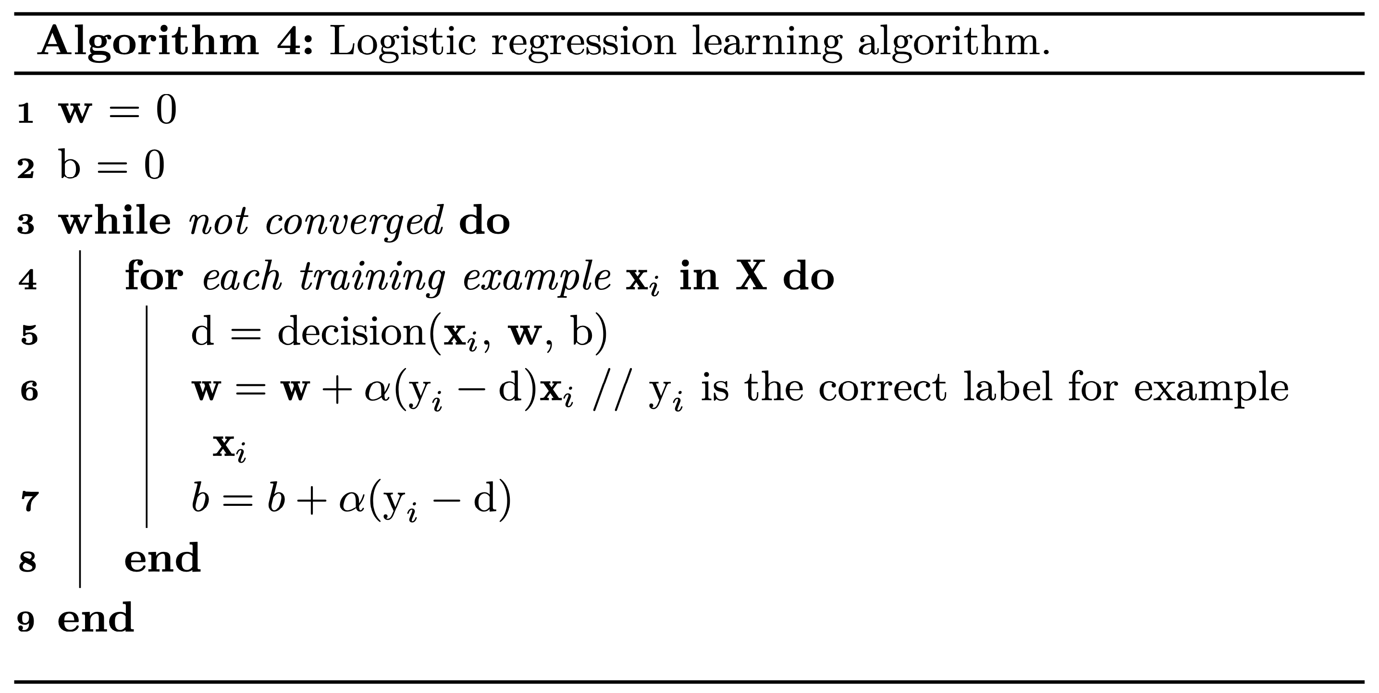
Peeking ahead: the LR training algorithm

Slide 6
Peeking ahead: the LR training algorithm
“Soft” updates: bigger for big mistakes, smaller for small ones

Slide 7
Peeking ahead: the LR learning algorithm
Learning rate: positive value that indicates the magnitude of the update

Slide 8
Deriving the lr learning algorithm

Slide 9
Do we need a probability theory detour?
What is probability?
What is conditional probability?
What is Bayes rule?
What is the law of total probability?
What are independent events?

Slide 10
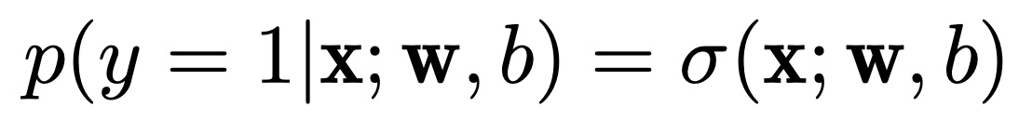
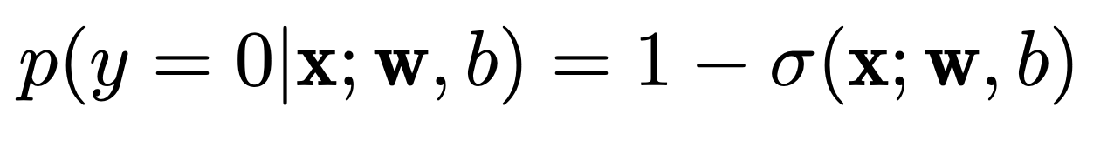
LR decision function = conditional probability
Probability of label 1
Probability of label 0
Probability of any label (syntactic sugar)

Slide 11
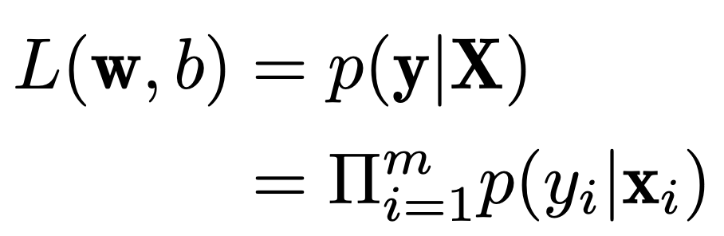
Likelihood of data and cost function
Likelihood of data
(A good learning algorithm will maximize it)
Why product here?

Slide 12
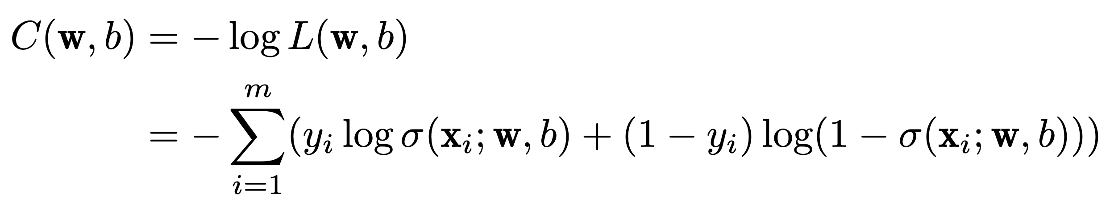
Likelihood of data and cost function
Cost function:
Positive function
Has large values when the model makes big mistakes
Thus, we want to minimize it
Why log?
Called negative log likelihood

Slide 13
Calculus to the rescue

Slide 14
How to minimize the cost function? Gradient descent to the rescue!
Gradient descent: finds the parameters (e.g., w and b for LR) that minimize a (convex) function by taking small steps towards the minimum
Function slope = derivative of f(x) with respect to x
What is the definition of a function’s derivative?

Slide 15
How to minimize the cost function? Gradient descent to the rescue!
Gradient descent: finds the parameters (e.g., w and b for LR) that minimize a (convex) function by taking small steps towards the minimum
Function slope = derivative of f(x) with respect to x
If negative, the function decreases
If positive, the function increases
If 0, we found a minimum or maximum
Gradient descent takes small steps in the opposite direction indicated by the slope

Slide 16
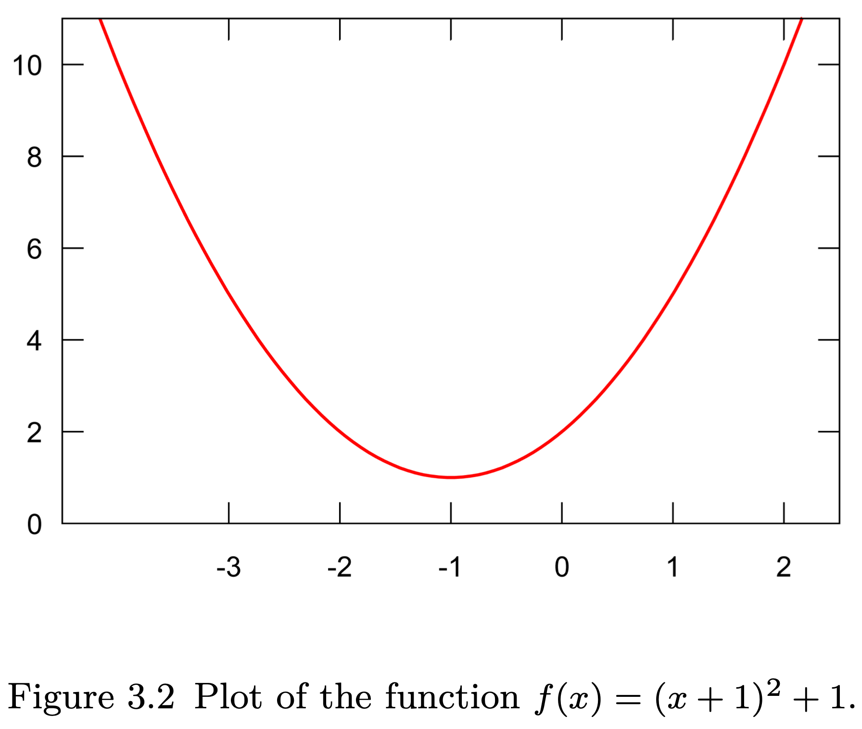
Gradient descent example
What is the derivative of this function?
Notes:
Derivative = 2(x + 1)

Slide 17
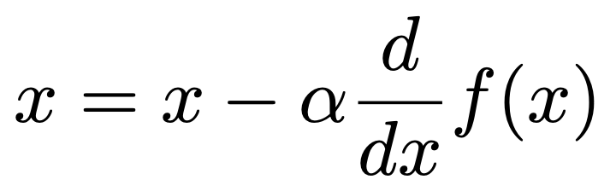
Gradient descent example
We initialize x randomly, and then repeatedly compute until we find the minimum
Steps:
x = -3
x = -3 – 0.1 x 2(-3+1) = -2.6
x = -2.6 – 0.1 x 2(-2.6 + 1) = -2.28
…
x = -1.001
Why do we need the learning rate?

Slide 18
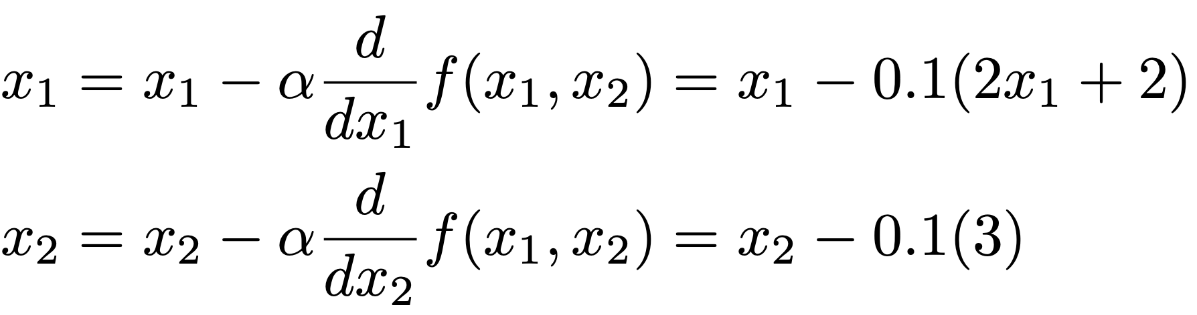
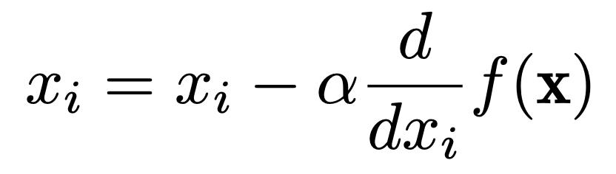
What about functions with multiple parameters?
Example: f(x₁, x₂) = (x₁ + 1)² + 3x₂ + 1
In each iteration:
In general:
Wait… Why not solve the equation where the derivative equals 0, as we were taught in calculus?

Slide 19
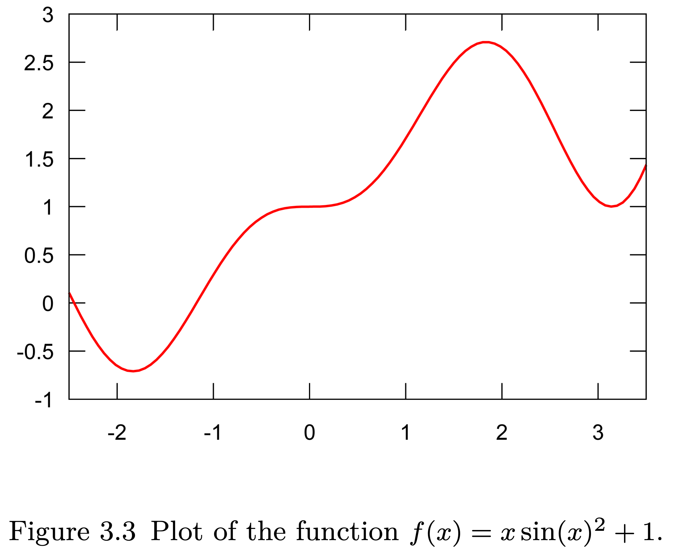
What about non-convex functions?

Slide 20
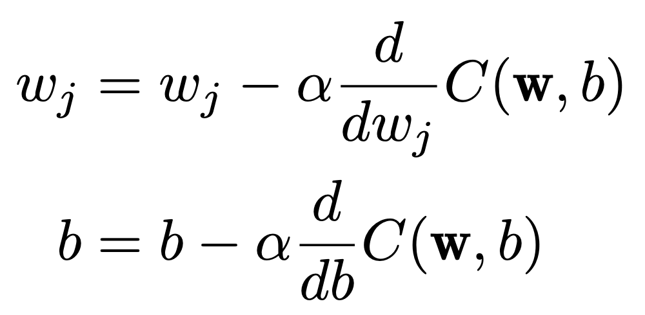
Minimizing the cost function
For all training examples:
For one training example:
Expensive because we need to compute C over all training examples
Stochastic gradient descent → online learning

Slide 21
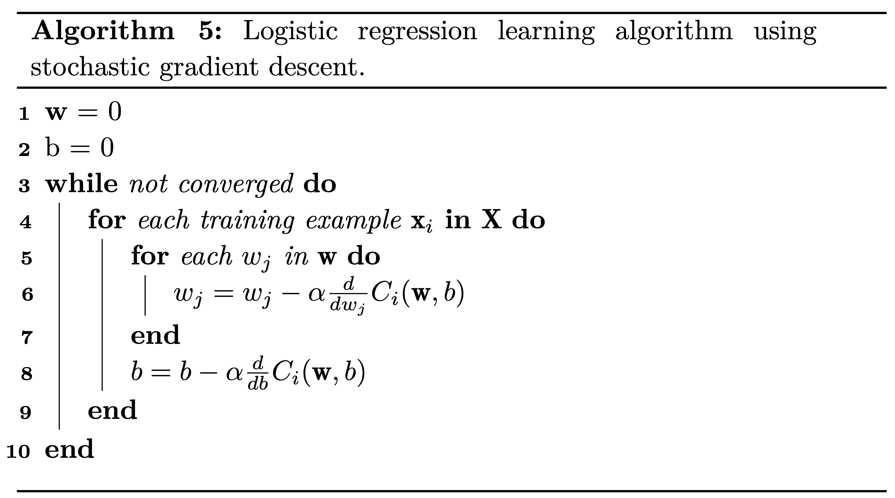
More formal algorithm

Slide 22
Computing the partial derivatives

Slide 23
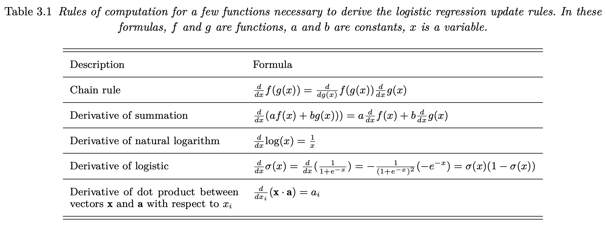
Rules of computation for derivatives

Slide 24
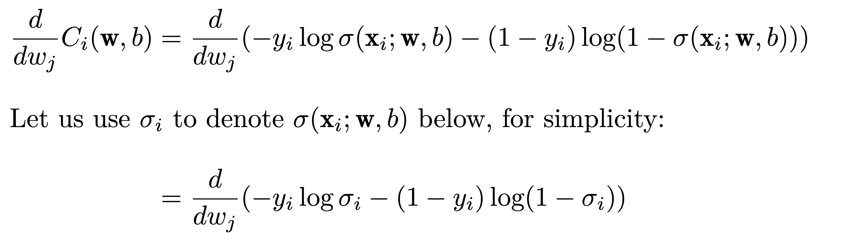
Partial derivative for w_{j}

Slide 25
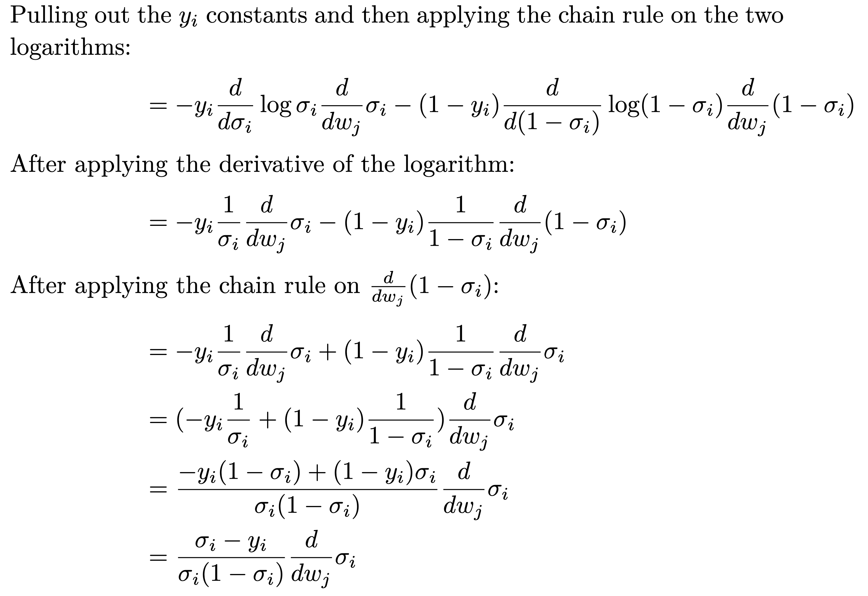
Partial derivative for w_{j}

Slide 26
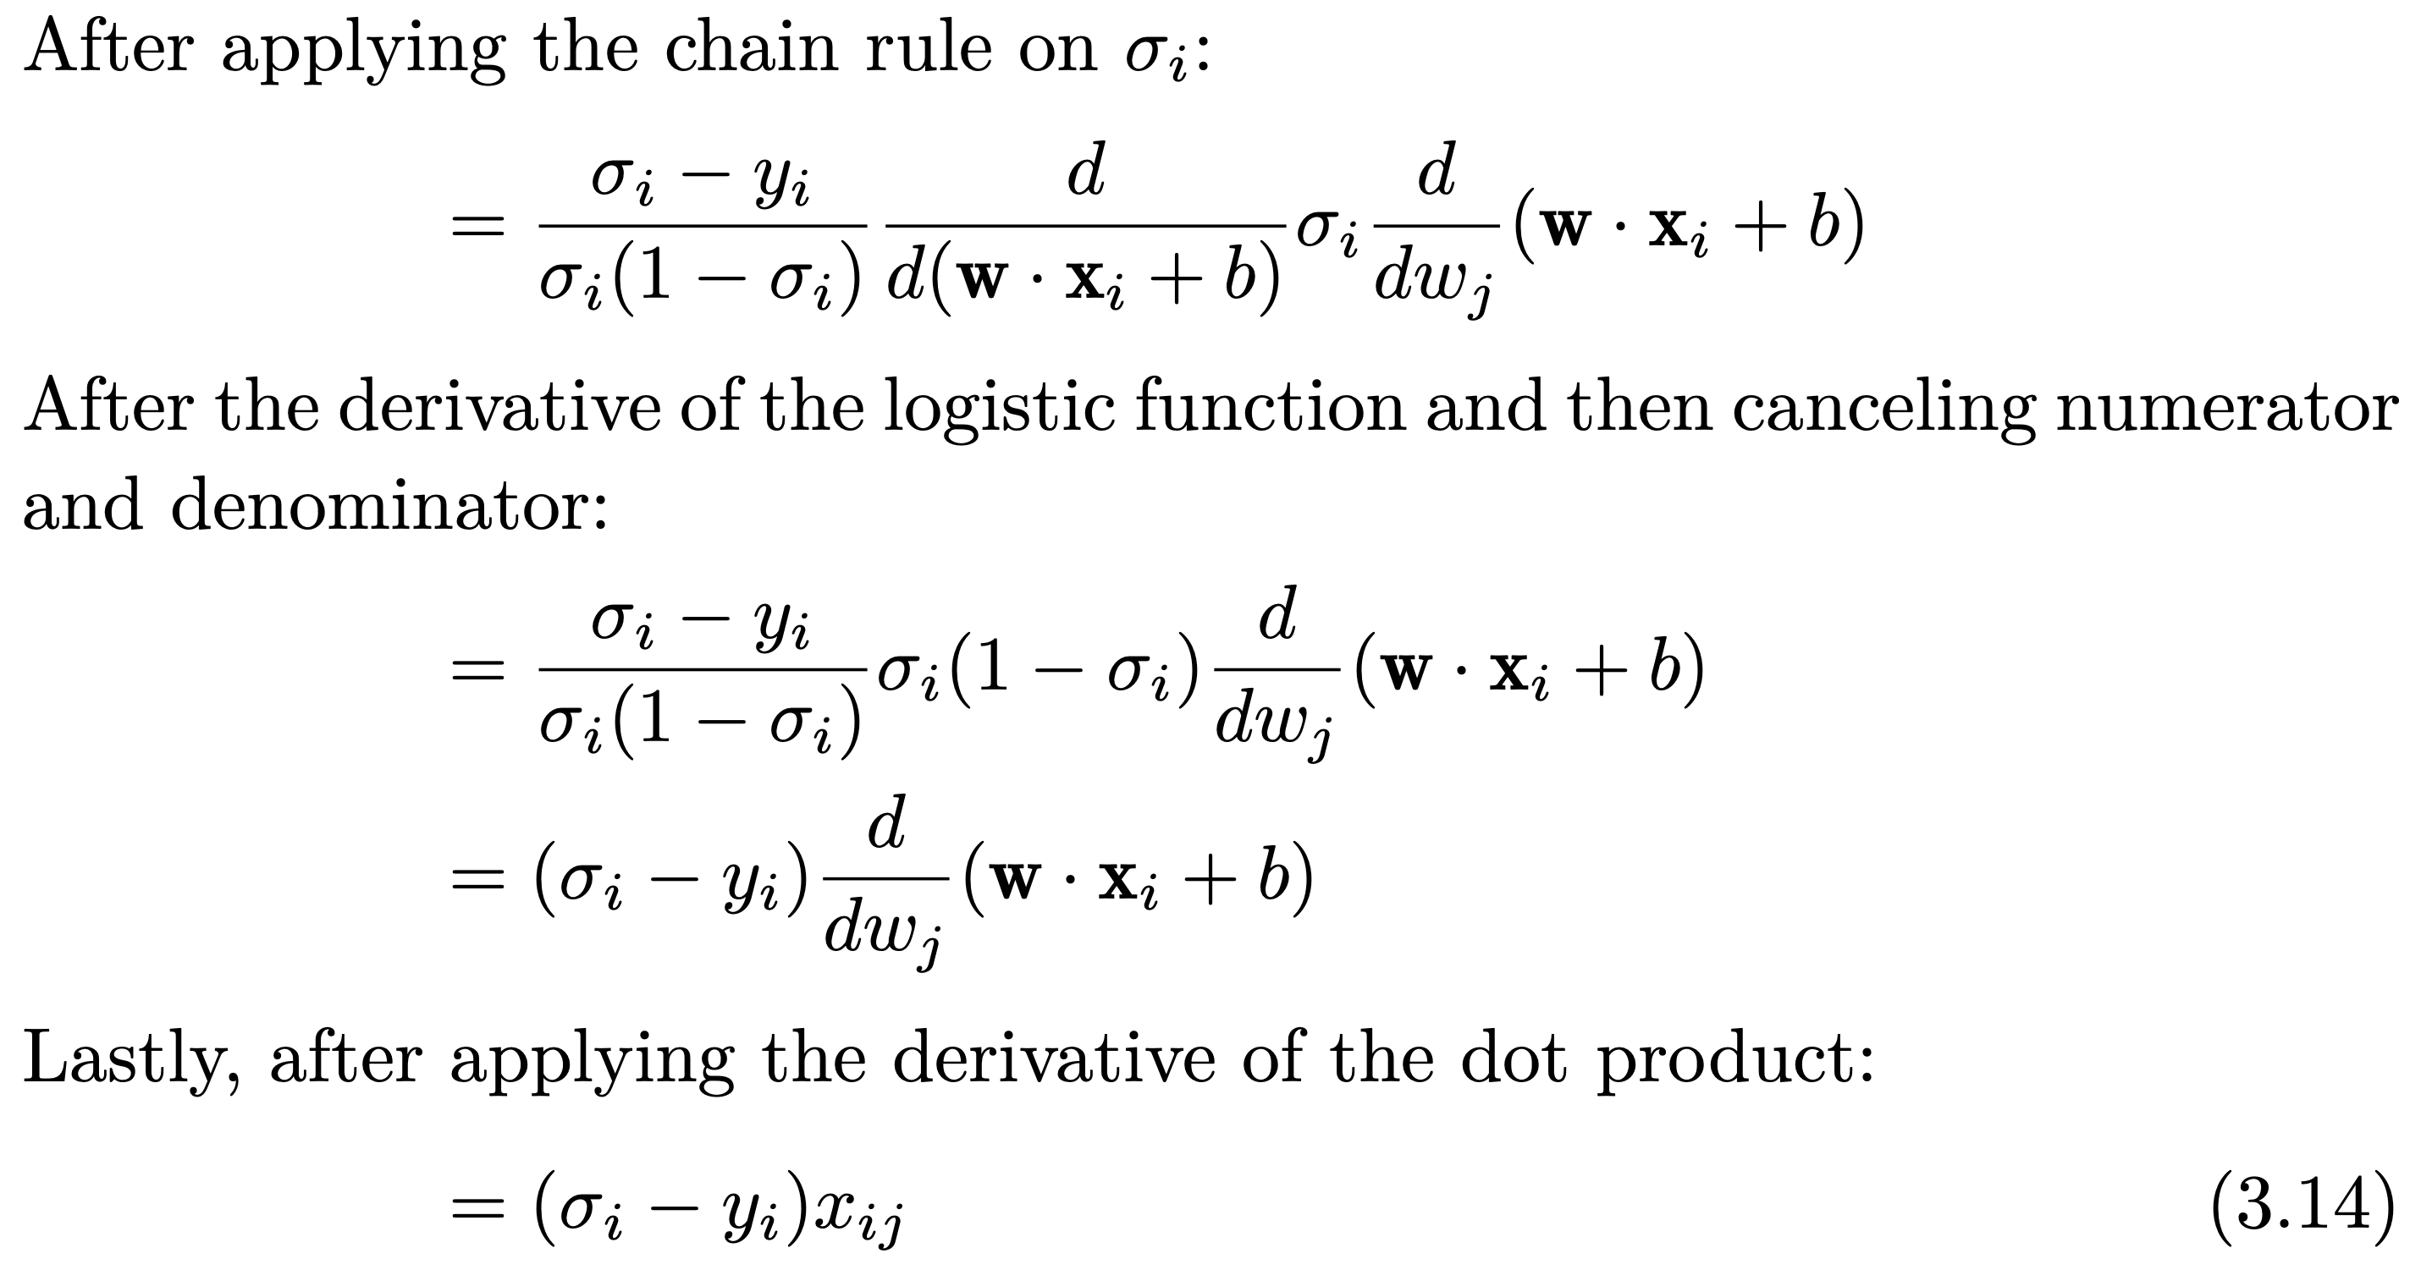
Partial derivative for w_{j}

Slide 27
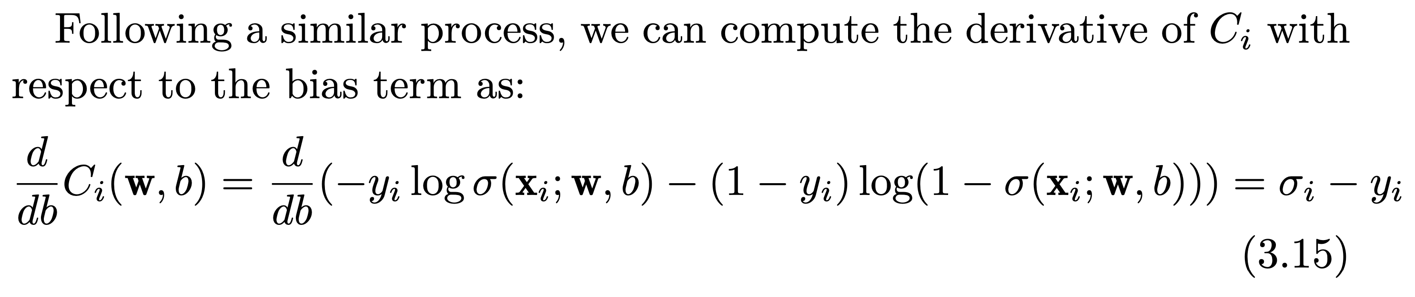
Partial derivative for bias

Slide 28
Plugging these derivatives in the learning algorithm we obtain…
This decision function is σ_{i}

Slide 29
Multiclass classification with LR

Slide 30
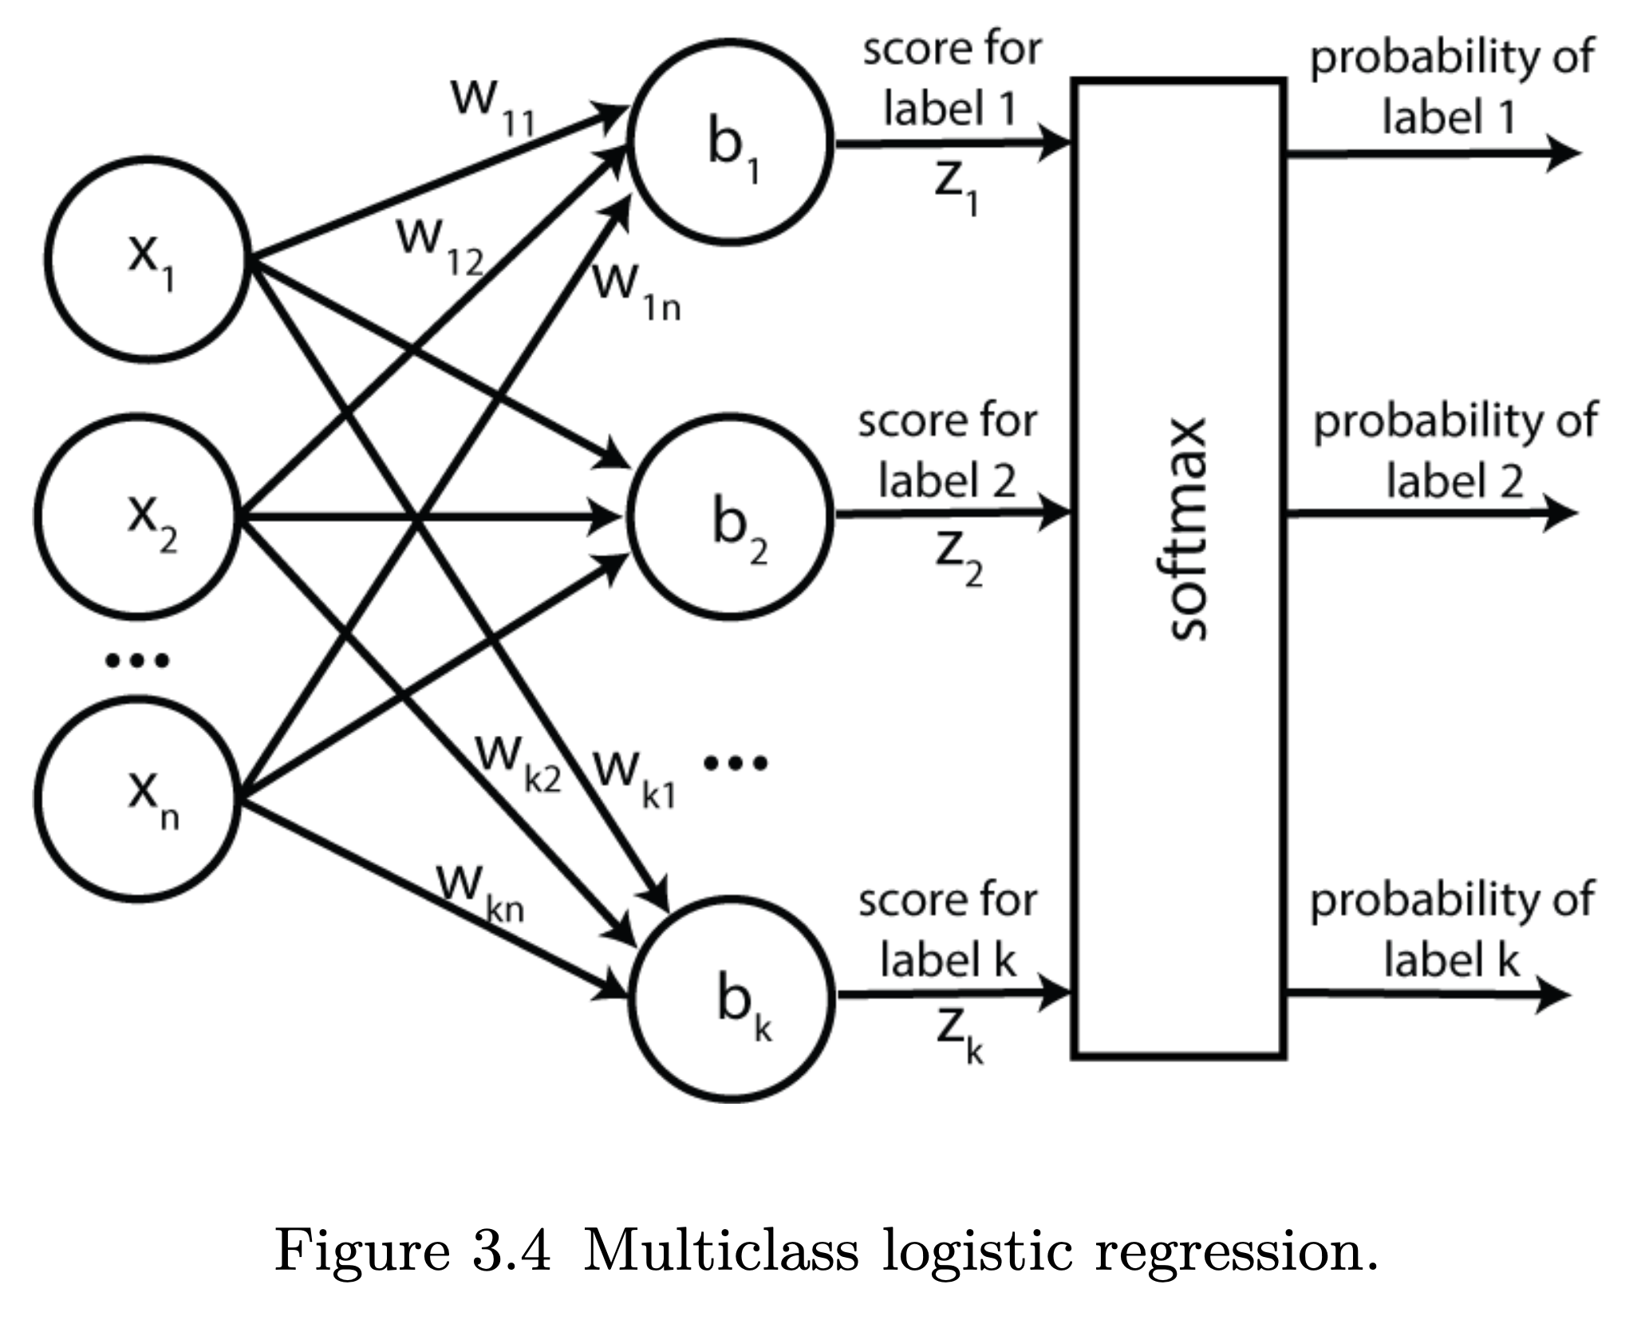
From binary to multiclass classification

Slide 31
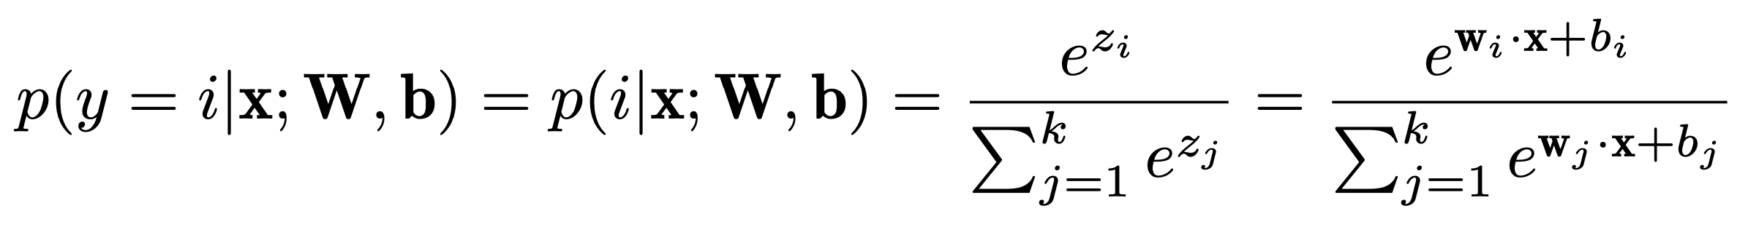
Multiclass probabilities
Softmax function

Slide 32
Softmax produces probabilities
The exponent function guarantees that the softmax values are positives
The denominator, which sums over all the k classes guarantees that the resulting values are between 0 and 1, and sum up to 1.

Slide 33
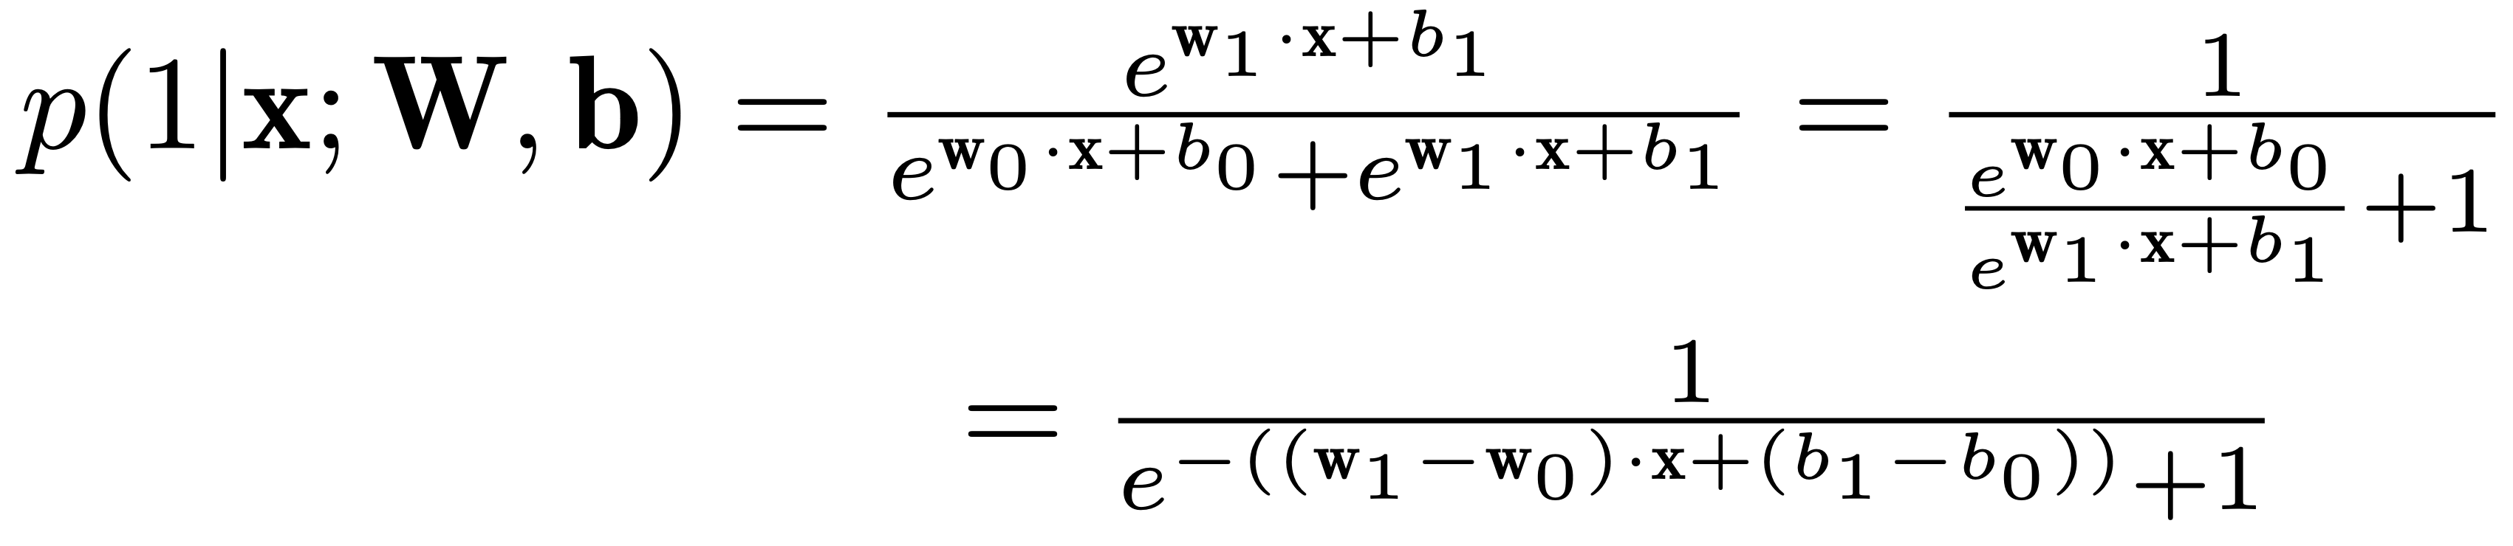
Softmax for 2 classes reduces to sigmoid!
A similar derivation can be shown for p(0|x;W,b)

Slide 34
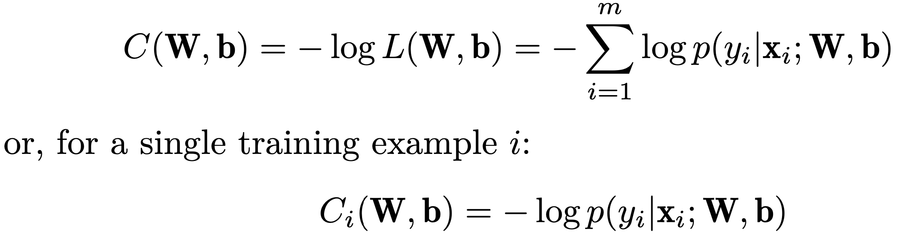
Cost function for multiclass LR
Cross entropy loss
Wait... ”cost” or “loss” function?

Slide 35
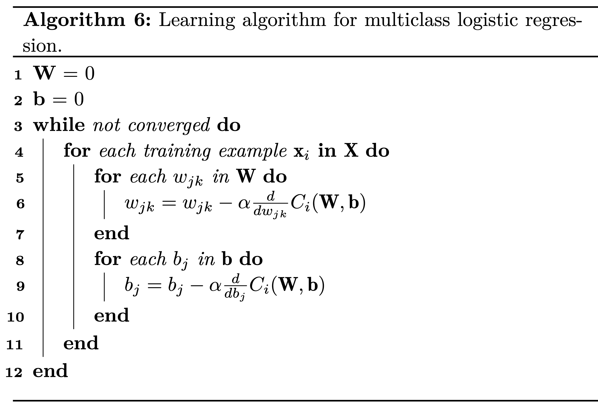
Learning algorithm for multiclass LR

Slide 36
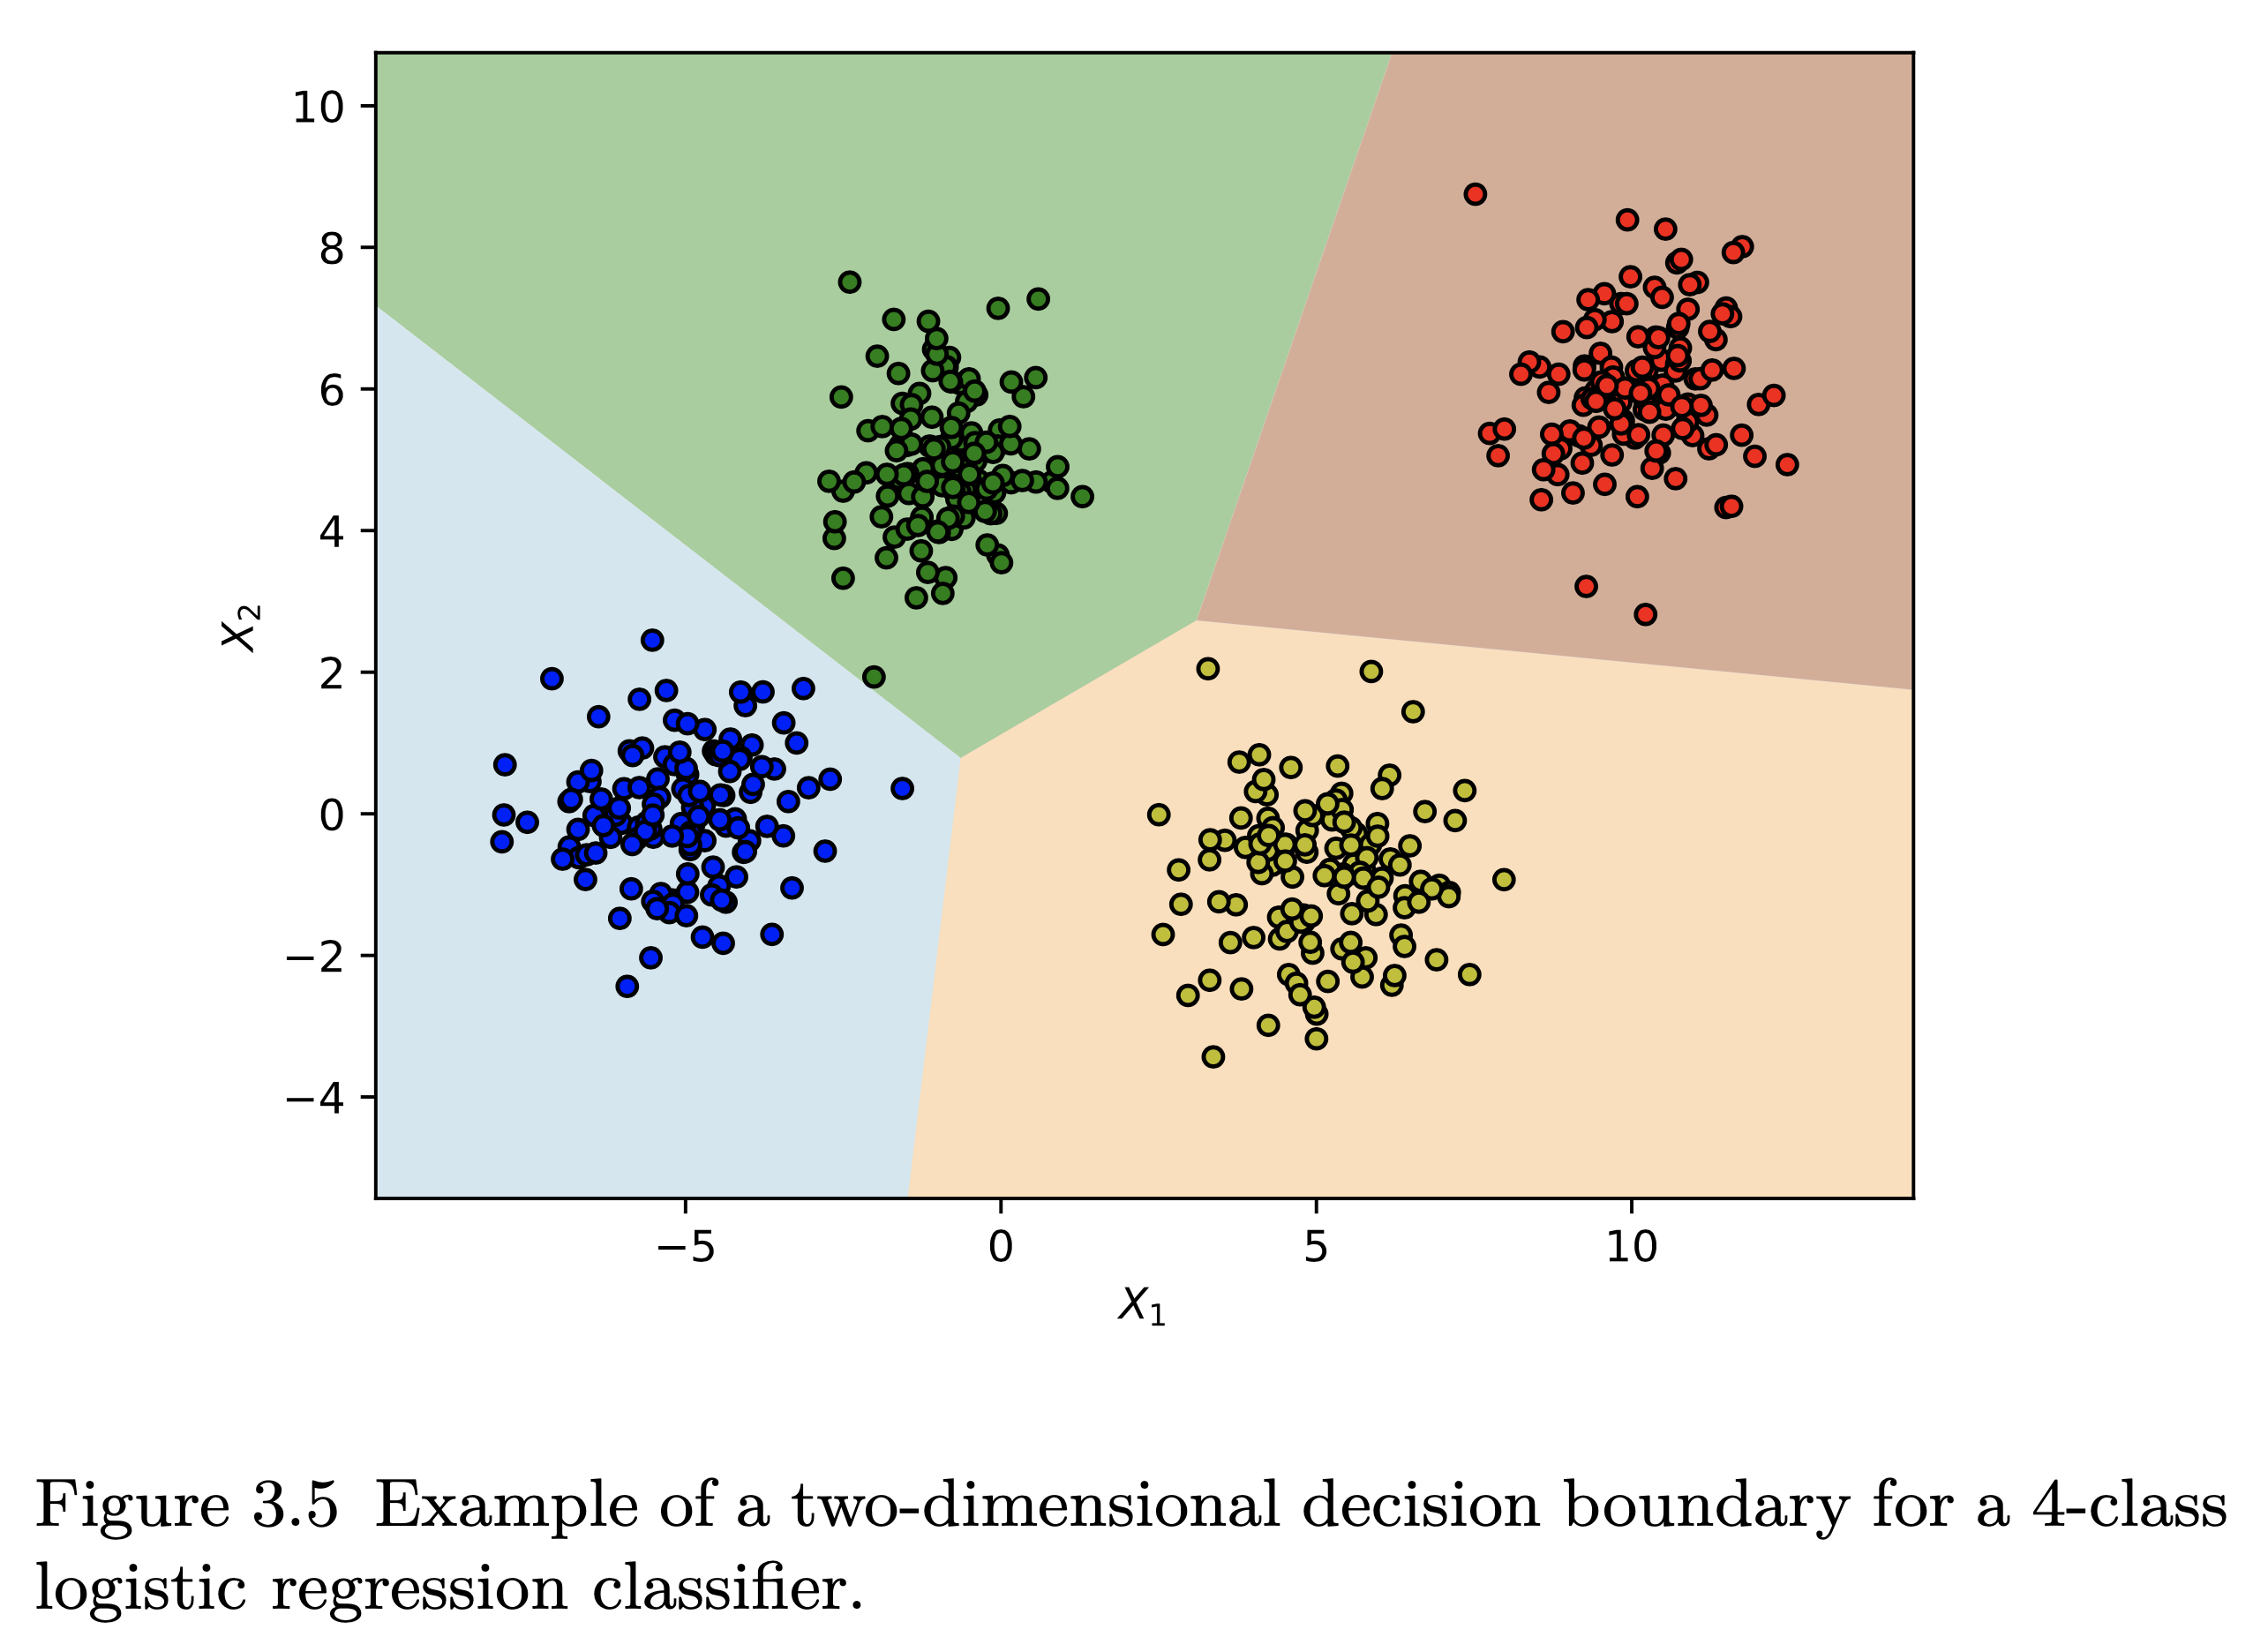
Decision boundaries for multiclass LR

Slide 37
Evaluation measures for multiclass classification

Slide 38
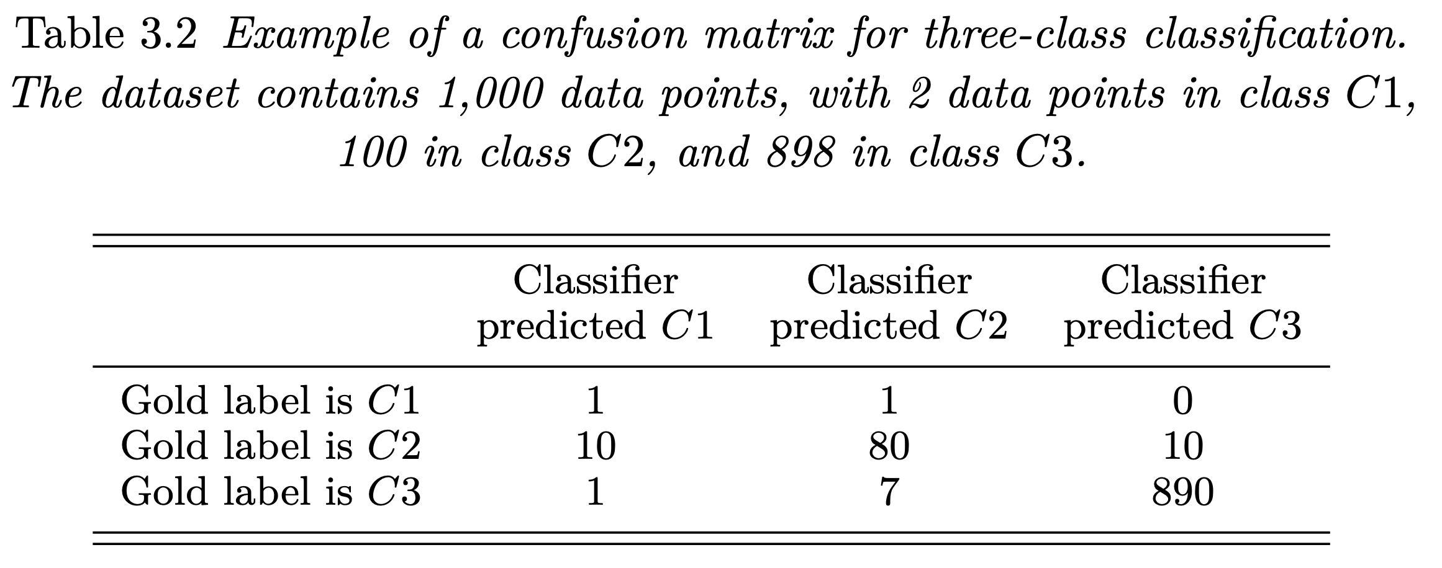
Example

Slide 39
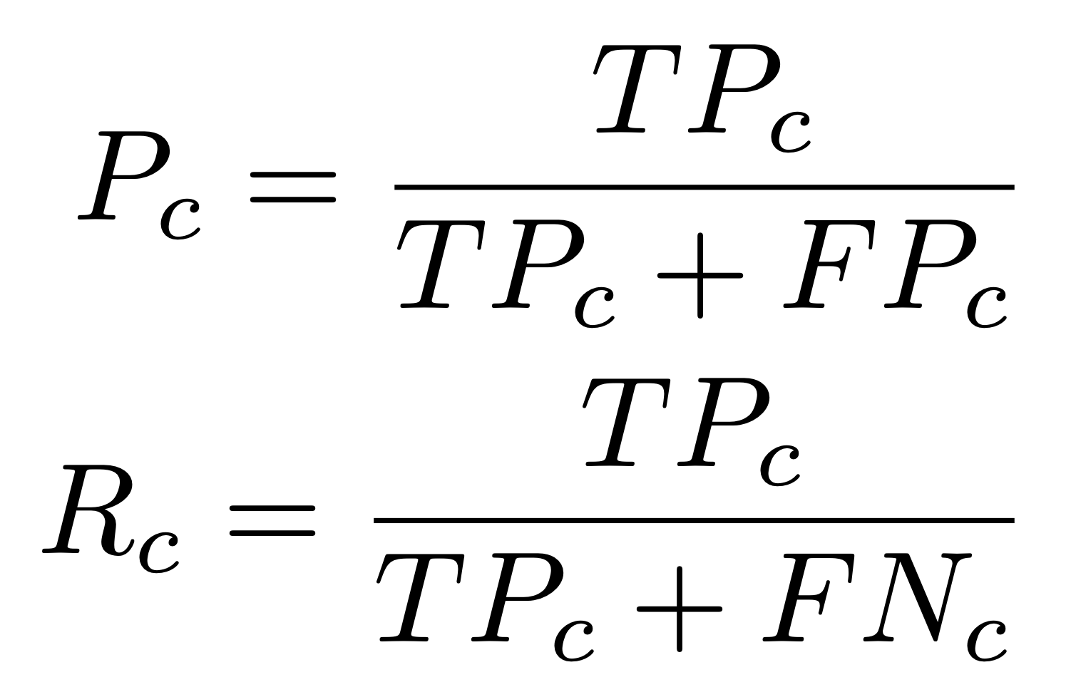
Precision/recall for a single class
What is FP_{c} and FN_{c} for class C2 in the previous example? What is its precision and recall?
Notes:
FPc2 = 1 + 7
FNc2 = 10 + 10

Slide 40
Overall measures
The important discussion for multiclass classification is how to average these sets of precision/recall scores into single values that give us a quick understanding of the classifier’s performance.
Two strategies: macro and micro

Slide 41
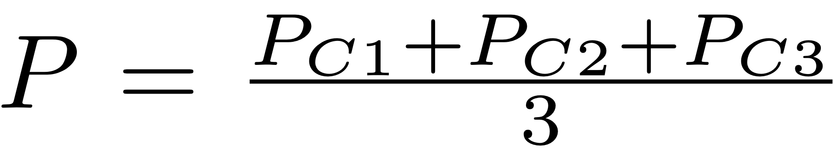
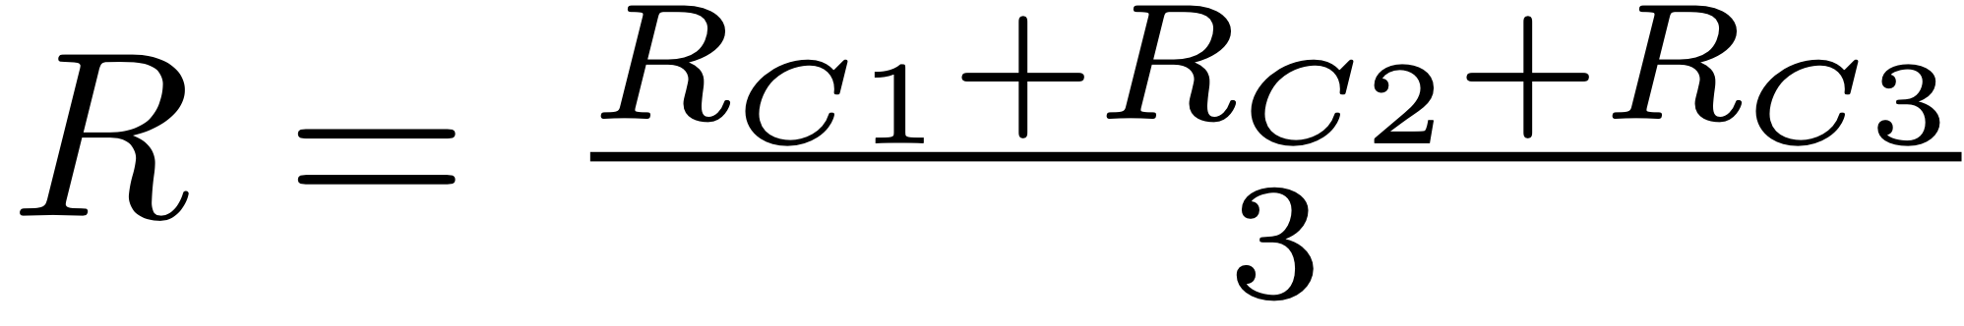
Macro averaging
Macro P/R = simple averages of P and R scores:
Macro F1 is the harmonic mean of macro P and macro R
Macro P/R/F1 may exclude the dominant class if not interesting to the task at hand
Advantage: all classes are treated equally
Disadvantage: all classes are treated equally

Slide 42
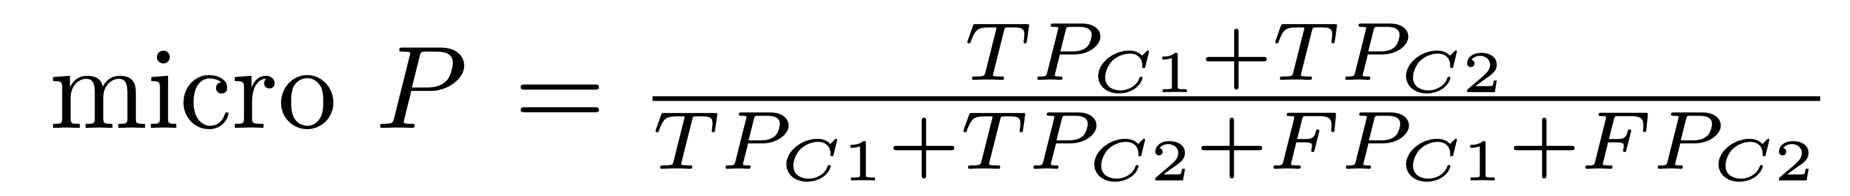
Micro averaging
Each class contributes proportionally with its frequency in the data
For example, the micro P and R for classes C1 and C2 are:
Micro P and R can exclude counts from the class that is not of interest for the task at hand
Micro F1 is the harmonic mean of micro P and micro R

Slide 43
Exercise
What are the macro and micro P and R for the previous example, assuming classes C1 and C2 are the classes of interest?
Why are micro values higher than macro in this case?
Is this always going to be the case?

Slide 44
Drawbacks of logistic regression
Similar to the perceptron, LR is a linear classifier
Addressed in chapter 5
Relies on hand-crafted features
Discussed in chapter 8
It cannot produce structured output
Chapter 10 and beyond

Slide 45
Take away
Logistic regression (LR) decision function
Learning algorithm for LR
LR cost function
Gradient descent
Deriving the LR update rule
From binary to multiclass classification
Evaluation measures for multiclass classification
Drawbacks

